Slide 1
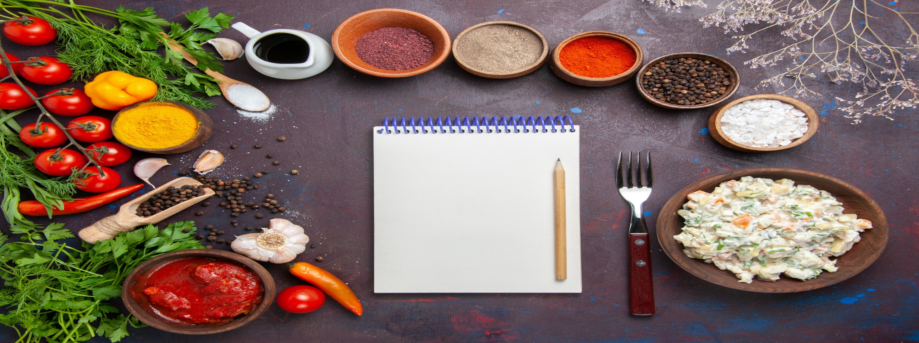
ONLINE RECIPE BOOK APPLICATION

Slide 2
Introduction:
Create an online recipe book where users can browse, search, and save recipes. This project aims to provide a user-friendly platform for food enthusiasts to discover and organize their favorite recipes.

Slide 3
Minimum Viable Product (MVP):
1.) Display a collection of recipes with images, titles, ingredients, and instructions.
2.) Implement search functionality to allow users to search for recipes by name or ingredients.
3.) Allows users to save their favorite recipes to a "My Recipes" section.
4.) Design a responsive and intuitive user interface for seamless navigation.

Slide 4
FEATURES
1.) Recipe Categories:
Organize recipes into categories like breakfast, lunch, dinner, desserts, etc.
2.) User Authentication:
Implement user accounts for saving and managing recipes.
3.) Rating and Reviews:
Enable users to rate and review recipes they have tried.
4.) Shopping List:
Provide an option for users to add recipe ingredients to a shopping list.
5.) Social Sharing:
Allow users to share recipes on social media platforms.

Slide 5
OBJECTIVES
1.) Create a visually appealing and functional recipe browsing experience.
2.) Ensure user engagement through features like ratings, reviews, and social sharing.
3.) Develop a responsive design that works well on desktop and mobile devices.
4.) Integrate user authentication for personalized recipe saving and management.

Slide 6
Layout with SmartArt
Recipe App
Add recipes
Edit recipes
Delete recipes
+/- ingredients
View recipes
Search for recipes
1.) Add recipes
2.) Edit recipes
3.) Delete recipes
4.) Add/remove ingredients
5.) View recipes
6.) Search for recipes
And more…

Slide 7
CHALLENGES EXPErienced
1.) Implementing user authentication and secure data management.
2.) Designing an intuitive and efficient search and filter system for recipes.
3.) Ensuring cross-browser and cross-device compatibility for a seamless user experience.
4.) Implementing user engagement through features like ratings, reviews, and social sharing.

Slide 8
MEETING PROJECT REQUIREMENTS
Recipe App
HTML
CSS
JavaScript
Bootstrap
MealDB API
The project will use HTML, CSS, and JavaScript to build a single-page application (SPA) that interacts with a public API to fetch recipe data asynchronously. It will incorporate event listeners for interactivity, array iteration for data manipulation, and adhere to coding best practices for maintainability and scalability.

Slide 9
API TO BE USED
MealDB API:
(https://www.themealdb.com/api.php)

Slide 10

DEMO VIDEO

Slide 11
Q & A
Feel free to ask questions.

